Slide 1
P-396
Bank Loan Analysis
Christina John Alappatt
Pratik Nalawade
Shashwat Shukla
Sushant Dhawale
Tabassum Shaikh

Slide 2

Table of Content
Introduction
Our Analysis
Observation
Dashboards
Conclusions

Slide 3
Introduction
The project aim is to analyze the Finance dataset of bank loan of customers, through a report to get insights from it by using different software tools such as Excel, MySQL, Tableau and Power Bi.
We have used the above tools for analyzing, cleaning and removing duplicates from the datasets and prepared dashboards and using the insights, accurate business decisions are made.

Slide 4
Our Analysis
Year wise loan amount Stats.
Grade and subgrade wise revol bal.
Total Payment for Verified Status Vs Non Verified Status.
State wise and Month wise Loan status.
Home ownership vs Last payment date stats.

Slide 5
Analysis 1 - Year wise loan amount Stats
Summary:
Perform year-over-year growth analysis, calculate average loan amounts, visualize loan amount distributions, explore correlations with external factors and conduct segmentation analysis.

Slide 6
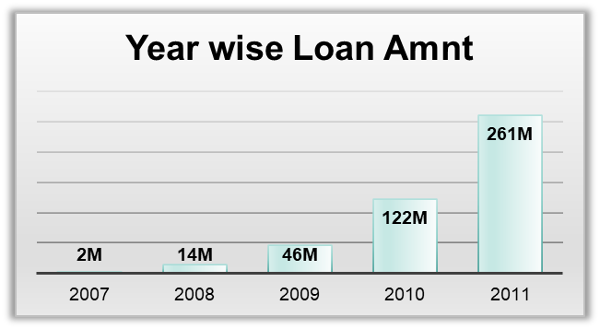

Observation:
●The Loan Amount is directly proportional to the increasing Years.
●Loan Amount varies from $2.22M to $260.51M.
●2010 saw the highest loan amount at 122M, indicating strong recovery post-recession.
●Percentage increase in Loan Amount between the consecutive years:
Though there is substantial increase in Loan Amounts but growth rates have reduced Yearly.

Slide 7
Recommendations:
Strengthen risk management practices.
Encourage portfolio diversification.
Invest in technology for efficiency.
Monitor economic indicators for market shifts.

Slide 8
Analysis 2 : Grade and subgrade wise revol bal.
Summary
The outcome of grade and subgrade-wise revolving balance in bank loans typically involves assessing the distribution of loan balances across different grades and sub-grades.
By monitoring revolving balances by grade and sub-grade, banks can better evaluate the performance and quality of their loan assets and take appropriate measures to mitigate risks and optimize portfolio performance

Slide 9
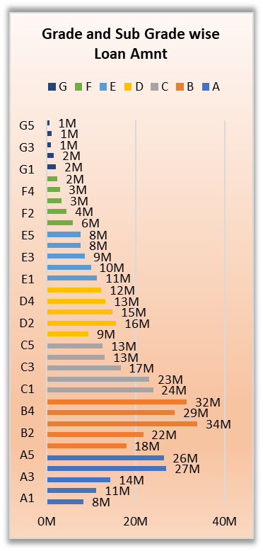
Observation
In this Grade and subgrade wise revol balance we can notice Grade B have more revol balance then any other grades & Grade G have very low revol balance.
The average revolving balance is higher in the ‘grade B’ its around 29M and the maximum reaches in the ‘sub-grade B1’ that is 39M, Same like the average lower revolving balance is in ‘grade G’ its around 1200K and the minimum reaches in the ‘sub-grade G5’ that is 701k.

Slide 10
Recommendations
Bank should aim to diversify their loan portfolio across different grades and sub-grades. This strategy would help them to reduce risk by balancing higher-risk loans with lower-risk loans.
Educating customers about the loan process, credit management, and responsible borrowing practices can contribute to better loan performance.

Slide 11
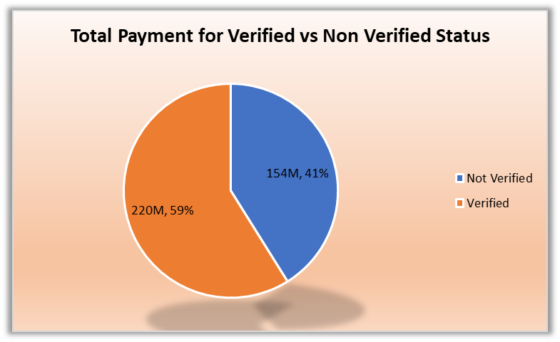
Analysis 3: Total Payment for Verified Status Vs Total Payment for Non Verified Status.
Observation : Total payments including verified status and non verified status were $324.13M out of which verified were $219.89M which is 58.88% of whole and Non verified $153.54M which is 41.12% of the total.
Debt consolidation and credit card loan are the maximum which are $236.65M
From 2008 onwards verified status started increasing by 12%
Recommendation: Total payment of verified status should be greater

Slide 12
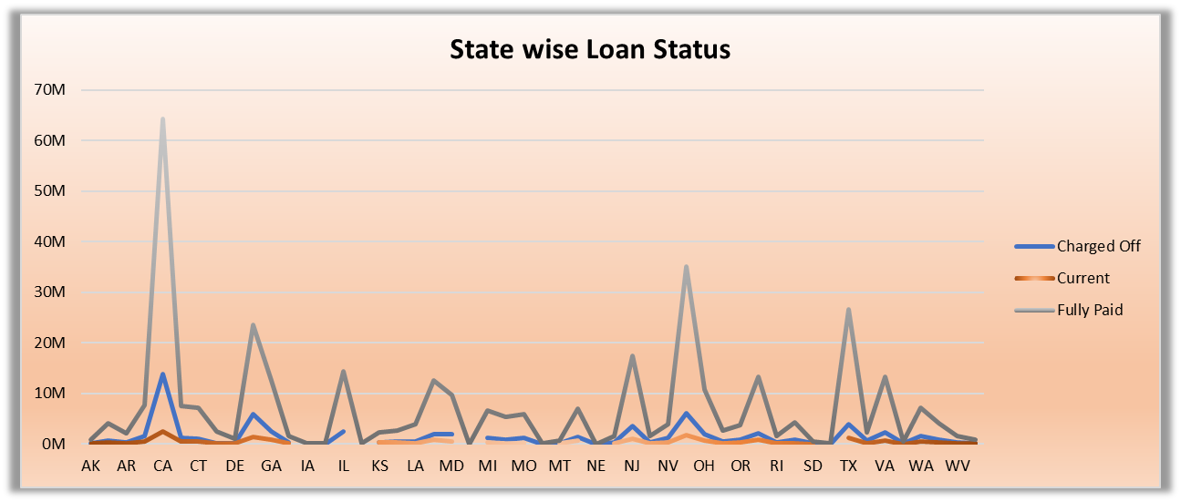
Analysis 4 : State wise and Month wise Loan status.
Summary :- By analysing the month wise and state wise loan status, we can mark insights about the behaviour of customers loan status by grouping them into state wise and month wise separately.
Observation:
By state wise loan status we can observe that CA,NY,TX,FL & NJ are the top 5 states according to the number of customers who have fully paid the amount.
By month wise loan status we can observe that Dec, Nov and Oct are the top 3 months according to the Customer's sum of fully paid amount.

Slide 13
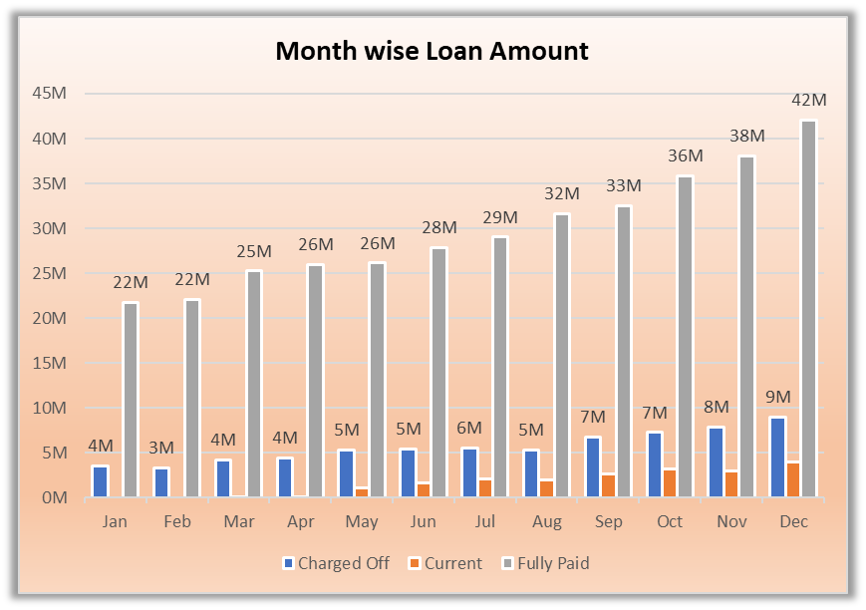
Recommendations:
Bank can consider focusing on states with lower loan counts to expand their Customer base and increase their lending activities.
By identifying states with high loan demand and modifying marketing strategies accordingly.

Slide 14
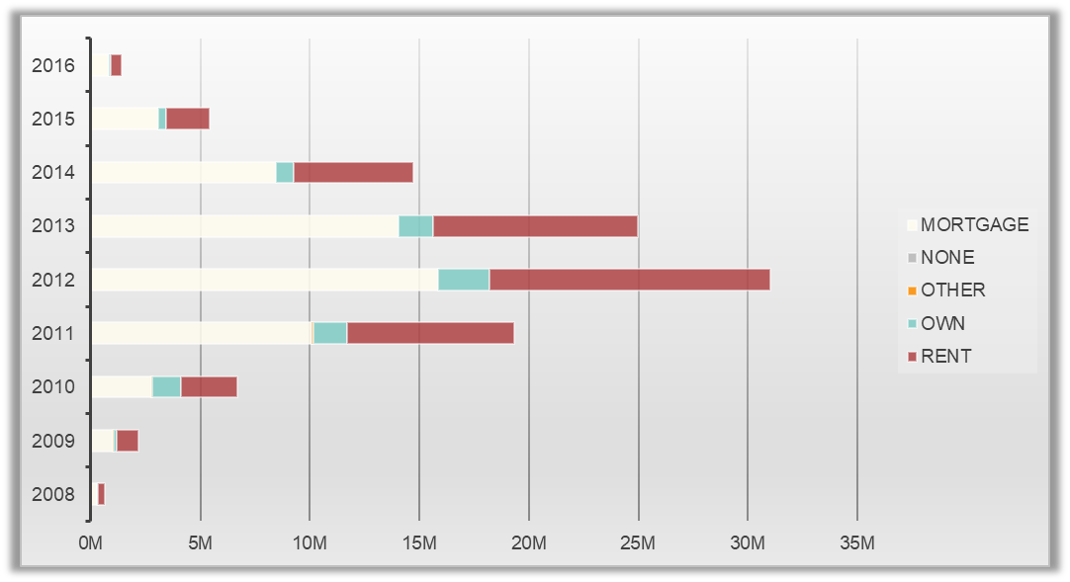
Analysis 5: Home ownership vs Last payment date stats.
Summary:
Examining the relationship between home ownership status and last payment date offers insights into the financial stability and payment behavior of homeowners versus renters.
loan payment amounts categorized by different types of housing (MORTGAGE, NONE, OTHER, OWN, RENT) over the years from 2008 to 2016. The numbers appear to represent the sum of last payment amounts for each housing type in each year, with a grand total provided for each housing type.

Slide 15
Observations:
Homeowners tend to have more consistent payment behavior, reflected in shorter average last payment dates compared to renters, who may exhibit more variability in payment timing.
Overall Trends: The total payment amounts seem to vary each year across different housing types.
Yearly Fluctuations: There are fluctuations in payment amounts from year to year for each housing type, suggesting potential changes in the number or value of loans or changes in payment behavior.
Housing Type Comparison: The data allows for comparison between different housing types regarding the total payment amounts. For instance, MORTGAGE and RENT appear to have the highest total payment amounts overall
Recommendation:
Leveraging homeowner status as a predictive variable in credit risk models can improve risk assessment accuracy and enable more targeted lending decisions.

Slide 16
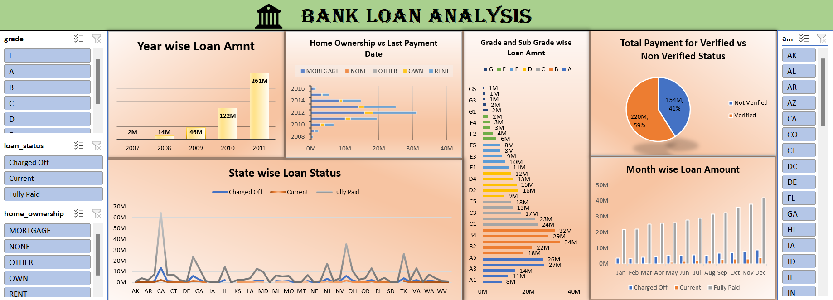
Excel Dashboard

Slide 17
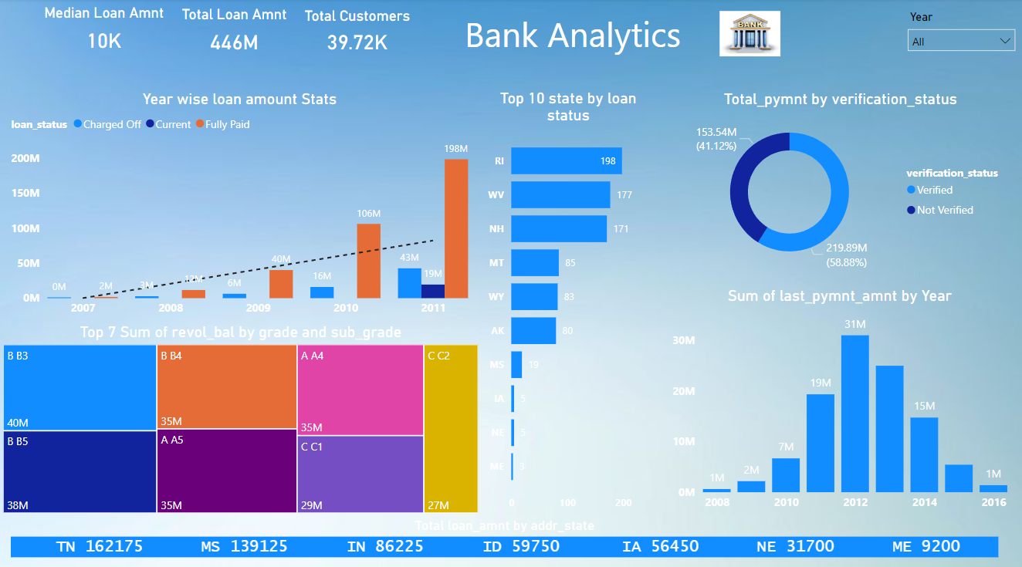
Power BI Dashboard

Slide 18
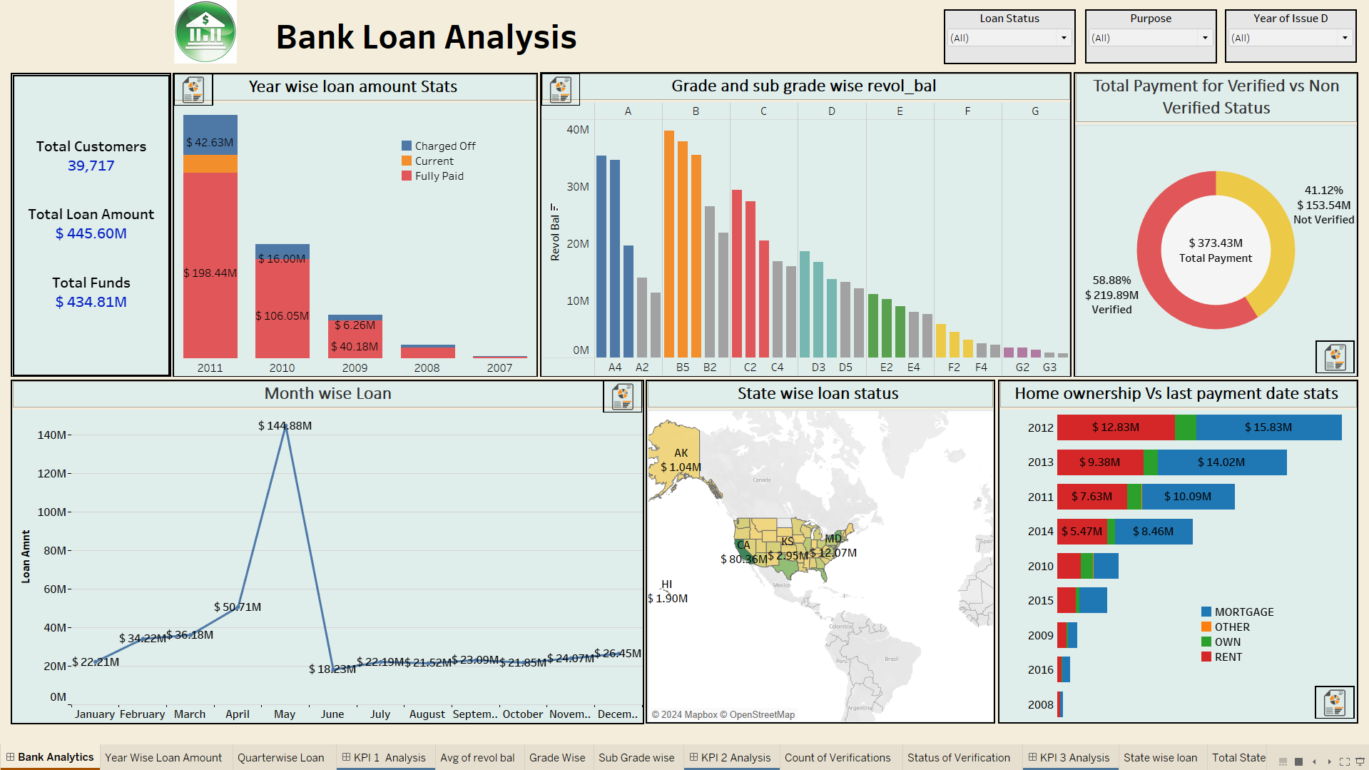
Tableau Dashboard

Slide 19
Conclusion
The comprehensive examination of key performance indicators (KPIs) related to loan data provides a multifaceted understanding of lending dynamics. Through analyzing trends in loan amounts over time, credit grade correlations with revolving balances, and the influence of borrower verification on repayment patterns, financial institutions gain valuable insights into borrower behavior and risk management strategies.
Additionally, insights into regional and temporal variations in loan performance, coupled with differences in payment behavior based on home ownership status, offer actionable intelligence for refining lending strategies and enhancing portfolio performance. By leveraging these observations, institutions can mitigate risk, optimize lending decisions, and ultimately drive sustainable growth and profitability in their lending operations.

Slide 20
Thank You!

